Slide 1
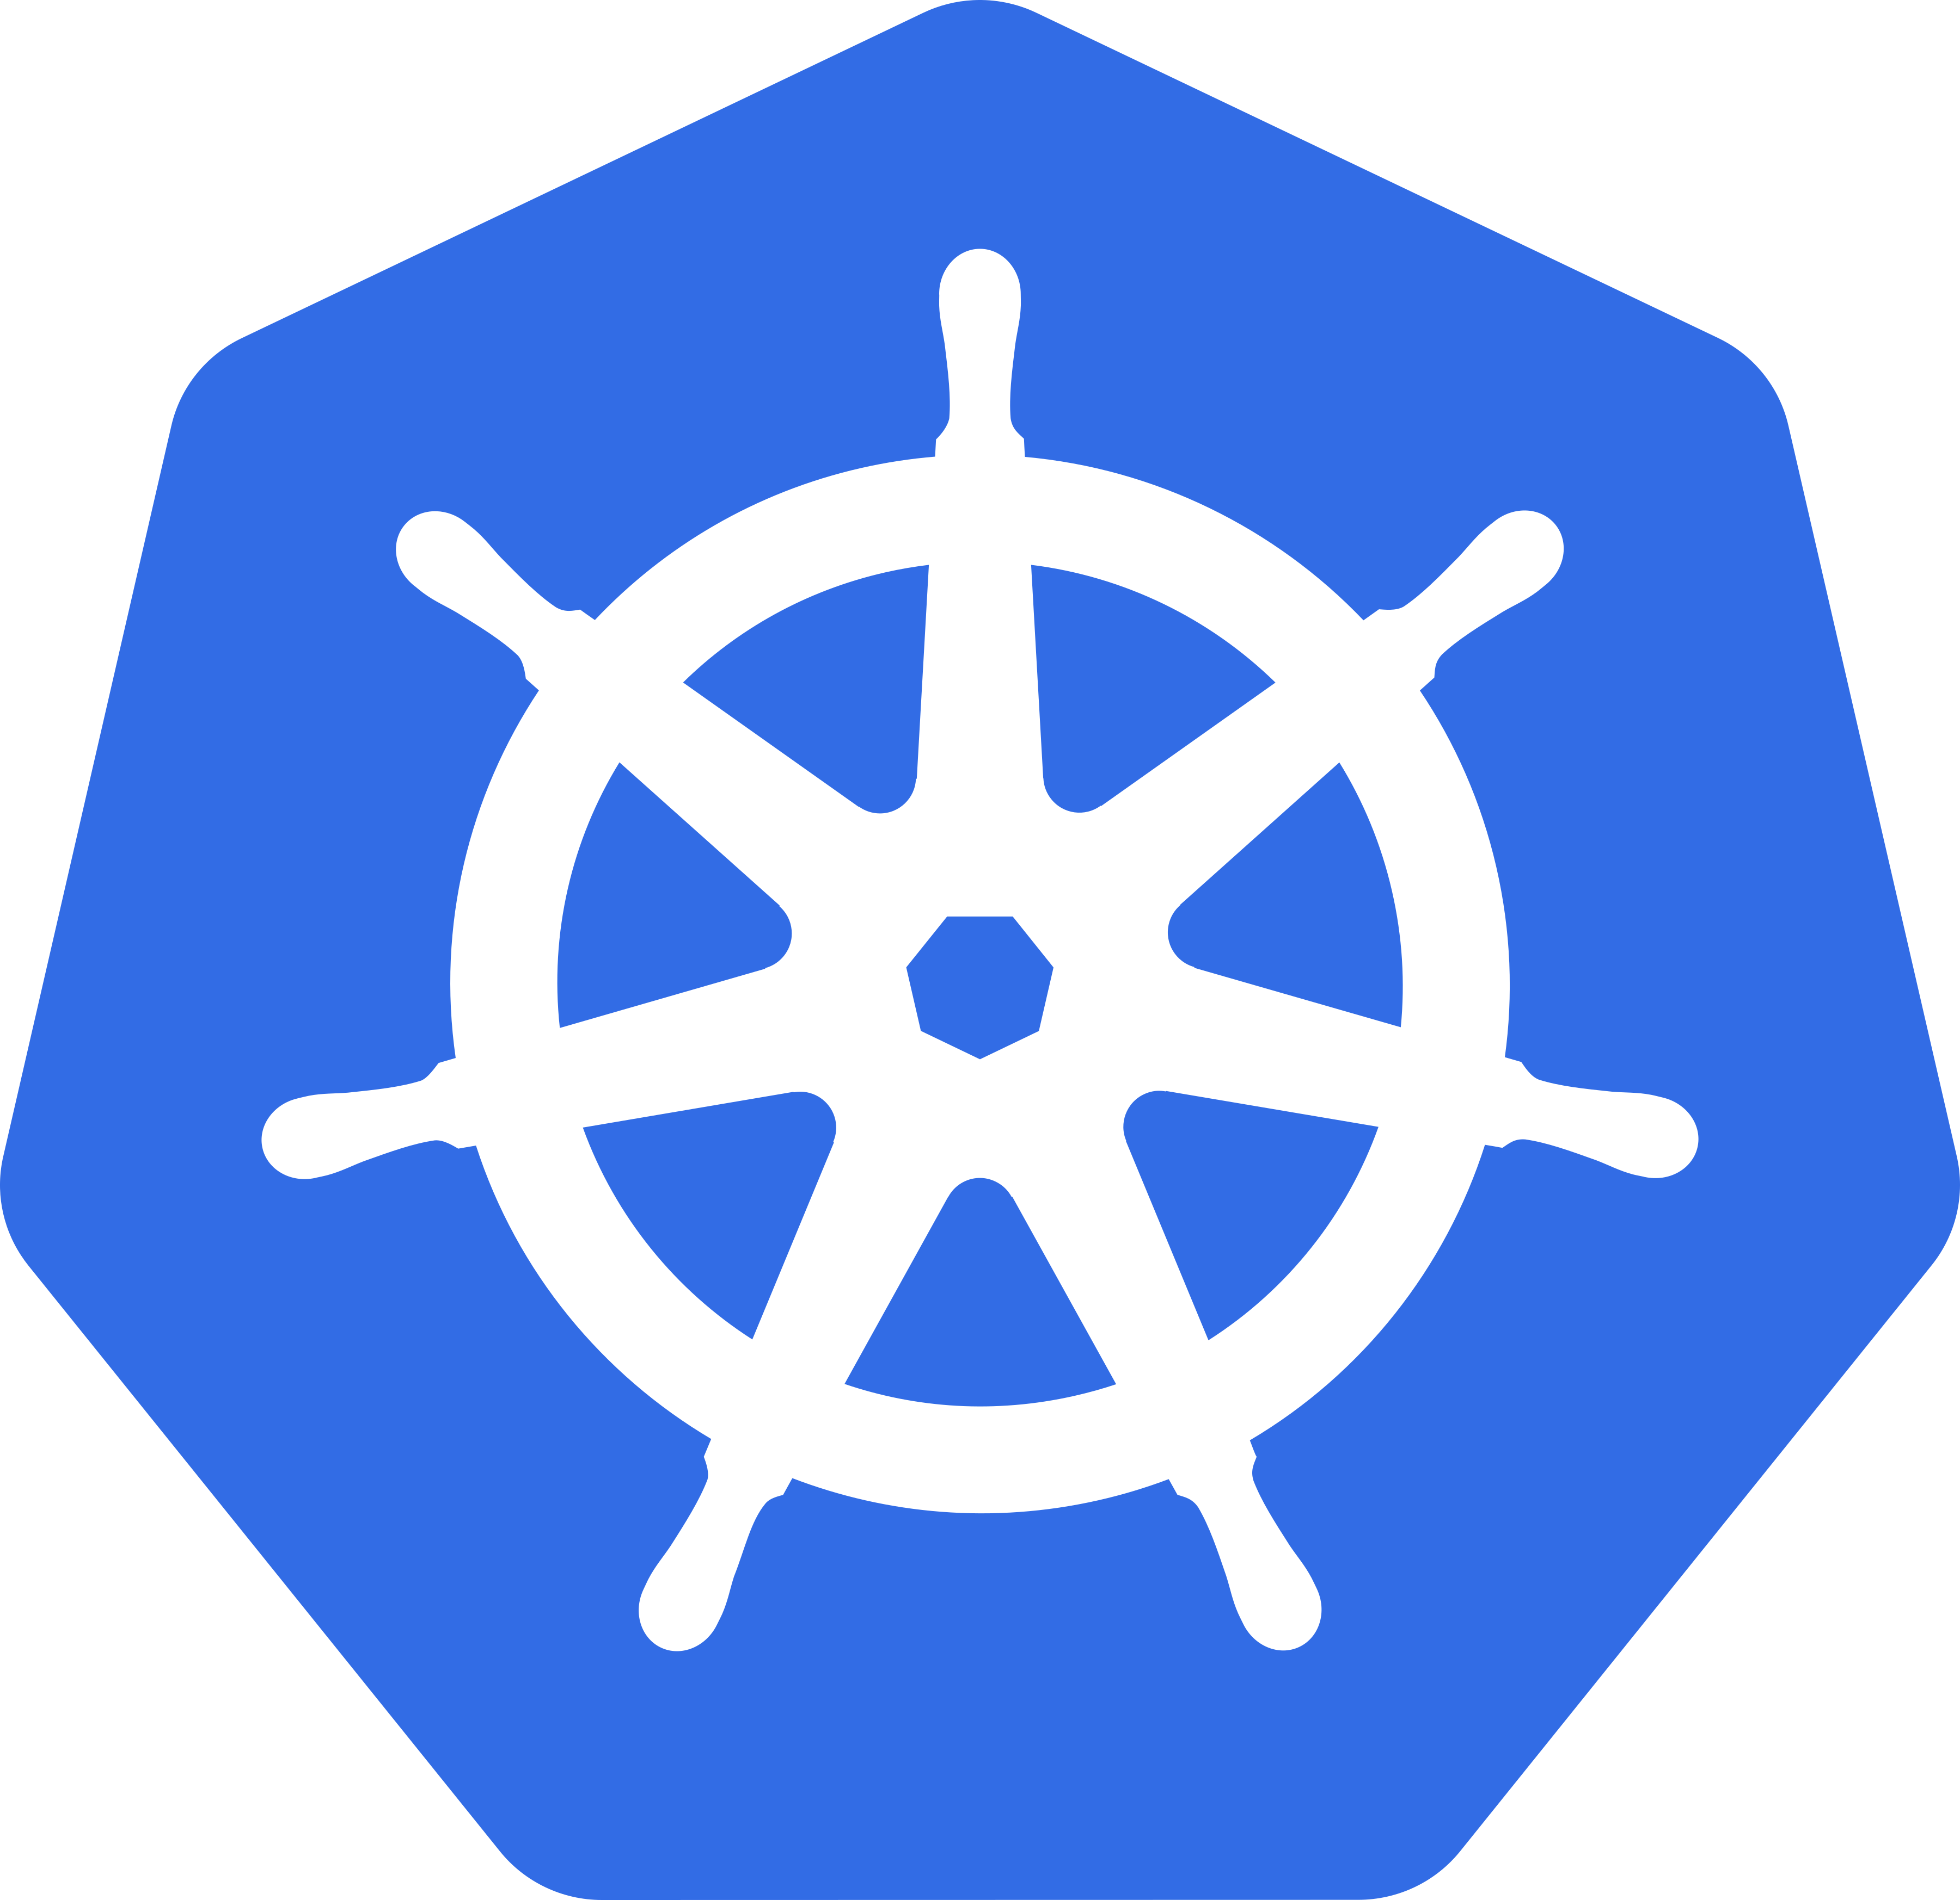
Kubernetes 101
Benji Banwart

Slide 2
Overview
What is Kubernetes?
An open-source platform designed to automate the deployment, scaling, and operation of application containers
Originally developed by Google and now maintained by the Cloud Native Computing Foundation (CNCF) as well as open-source contributors
Why is it important?
Scalability: Automatically manages the scaling of containerized applications
High Availability: Ensures applications are always running and accessible
Flexibility: Supports a wide range of container tools and orchestration platforms
Portability: Enables consistent environments across development, testing, and production
Community Support: Backed by a large, active community contributing to continuous improvement and innovation
2

Slide 3
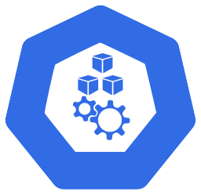
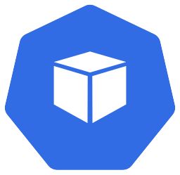
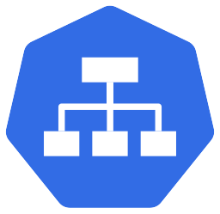

Basic Components
Cluster
Node
Pod
Service
Persistent Volume

Slide 4
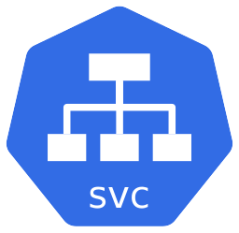

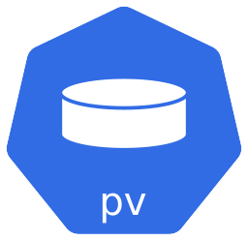
Kubernetes Architecture
Cluster
Node
Node
Node

Slide 5
A set of nodes (machines) that run containerized applications managed by Kubernetes
Contains the Control Plane and the Worker Nodes
Kubernetes Cluster

Slide 6
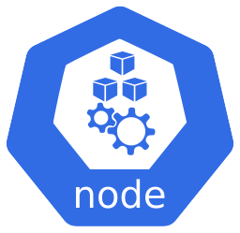
A physical or virtual machine
Contains pods and other middleware that is required to run applications
Responsible for running the containerized applications and providing the necessary computing resources

Slide 7
The smallest and most basic deployable unit in Kubernetes, representing a single instance of a running process in the cluster
Can run one or more containers, which share the same network namespace and storage volumes
Self Healing - Can be replaced if one fails
Can be duplicated in order to properly scale
Each will have its own IP address

Slide 8
Defines a logical set of pods and a policy for accessing them
Provides a single, stable endpoint to access a group of pods
Facilitates communication between pods as well as incoming communication from external sources (outside the cluster)

Slide 9
Provides a way for users to store and persist data independently of the lifecycle of Pods – (stateful apps)
Persistent Volume

Slide 10
Recap of Architecture
Cluster
Node
Node
Node

Slide 11
Time for a Demonstration

Slide 12
Any Questions?

Slide 13
Thank you
Benji Banwart

